Slide 1
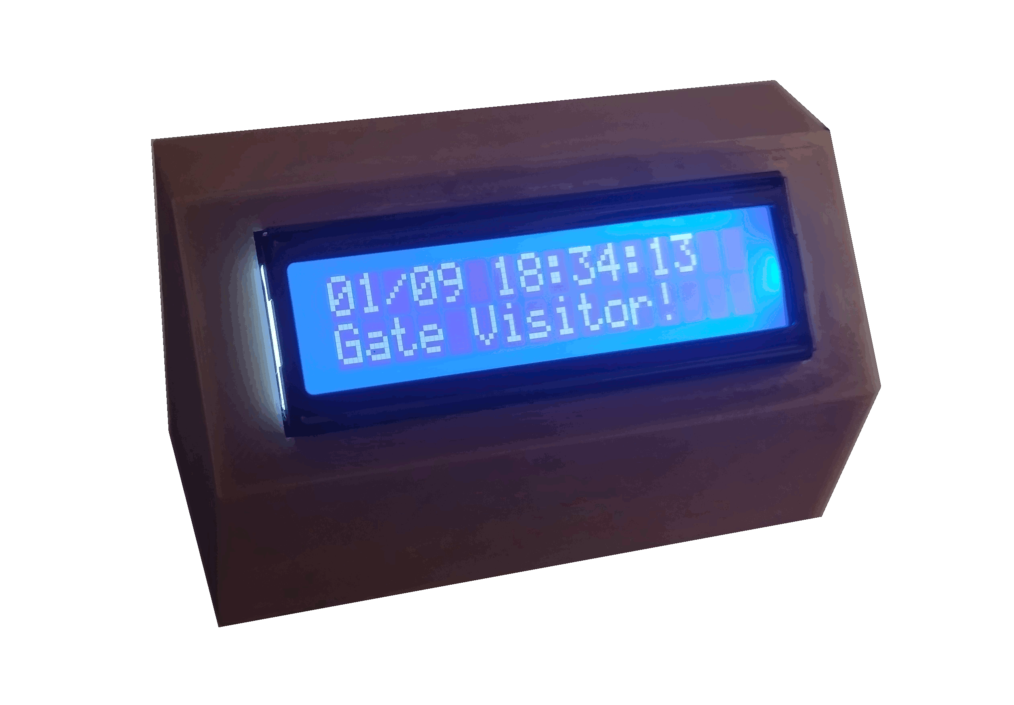
An MQTT Listener and Announcer
by David Powell

Slide 2
Use Cases
Notify household members of events that require immediate attention, such as
  Water leaks
  Refrigerator temperature too high
  Weather events
Announce arrival or departure of visitors
Any infrequent event that generates an MQTT message

Slide 3
Features
Listens for up to four different MQTT messages
Accepts topic and message wildcards
Displays custom text for each message
Plays a custom audio file for each message
Text with timestamp remain on display until next event is detected
Overall volume can be set as desired
Configured via serial port (for now)

Slide 4
Hardware Required
ESP8266 D1 Mini
DF Player mini MP3 player
Speaker
JHD162A LCD display (2x16)
3D printed case
Micro SD card

Slide 5
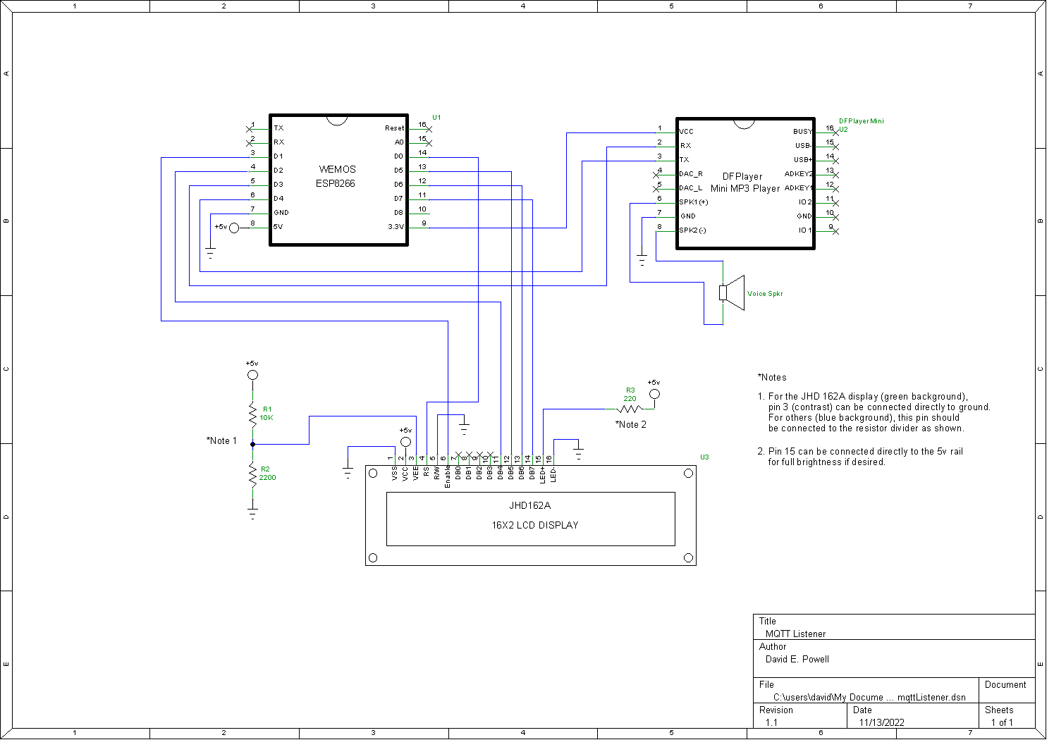
Schematic

Slide 6
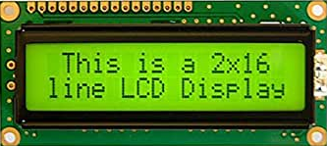

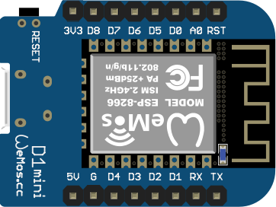
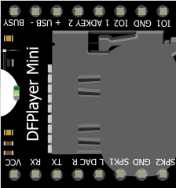
Block Diagram
MQTT
Broker

Slide 7
Operation (1 of 2)
Use a serial comm program to configure the device. The built-in serial monitor in Platform I/O or Arduino IDE works well.
Once the configuration is completed and the device is working, it can be configured via MQTT.
Sending a blank line or invalid text on the serial port will return all configurable parameters and their values.

Slide 8
Operation (2 of 2)
Record your messages as MP3 files on the micro SD card. IMPORTANT! The file names should be numbered (01.mp3, 02.mp3,etc.), but that's not how they are selected for playing! If the device needs to play the file for message 3, for example, it will play the 3rd file that was copied to the card, not necessarily the 03.mp3 file! This is not mentioned in the documentation, so I had to find it out the hard way. I think it's a bug.

Slide 9
Programming (1 of 2)
ssid=<wifi ssid> (xxxxxxxx)
wifipass=<wifi password> (xxxxxxxxxxxx)
broker=<address of MQTT broker> (192.168.0.99)
brokerPort=<port number MQTT broker> (1883)
userName=<user ID for MQTT broker> (xxxxxx)
userPass=<user password for MQTT broker> (xxxxxxxxx)
topic1=<MQTT topic for which to subscribe> (rtl_433/gate-host/devices/GateAlert/rows/+/data)
message1=<a message for topic 1> (720)
description1=<what to display when message1 is received> (Gate)
topic2=<MQTT topic for which to subscribe> (buteomont/house/water/runlimiter/status)
message2=<a message for topic 2> (timeout)
description2=<what to display when message2 is received> (Pump Timeout!)
topic3=<MQTT topic for which to subscribe> (rtl_433/HassServer/devices/PowellRidgeAlert/rows/+/data)
message3=<a message for topic 3> (timeout)
description3=<what to display when message3 is received> (Powell Ridge)

Slide 10
Programming (2 of 2)
topic4=<MQTT topic for which to subscribe> (desk/beep)
message4=<a message for topic 4> (test)
description4=<what to display when message4 is received> (Oh wow, so test!)
lwtMessage=<status message to send when power is removed> (disconnected)
commandTopic=<mqtt message for commands to this device> (buteomont/mqttListener)
gmtOffset=<Time offset from GMT> (-6)
volume=<Speaker volume 0-10> (10)
debug=<print debug messages to serial port> (true)
MQTT client ID=<automatically generated client ID> (mqttListenerfa0b) **Use "resetmqttid=yes" to regenerate
*** Use "factorydefaults=yes" to reset all settings ***

Slide 11
Possible Enhancements
Web server for easy configuration
Event logging (scrollback and/or download)
Remove 4-message limit
Higher resolution display

Slide 12
Notes
Those little 1” speakers don't sound very loud until they are mounted firmly in an enclosure. Their volume will surprise you when they are!
The DF Player supports stereo sound, if you want to use two speakers. Simply wire them from each speaker terminal to ground instead of between the speaker terminals.

Slide 13
Resources
ESP8266 D1 Mini
  https://smile.amazon.com/gp/product/B09SPYY61L
DF Player mini MP3 player
  https://smile.amazon.com/gp/product/B07Y2YKYRS
Speaker
  https://smile.amazon.com/gp/product/B07FMR5JGX
JHD162A LCD display (2x16)
  https://smile.amazon.com/Backlight-Alphanumeric-Display-Arduino-Raspberry/dp/B071HLFT99
Source code (Platform I/O) and case design (OpenSCAD)
  https://github.com/buteomont/mqttListener

